Slide 1

SIX WEEKS SUMMER TRAINING ON OBJECT ORIENTED PROGRAMMING USING PYTHON

Slide 2
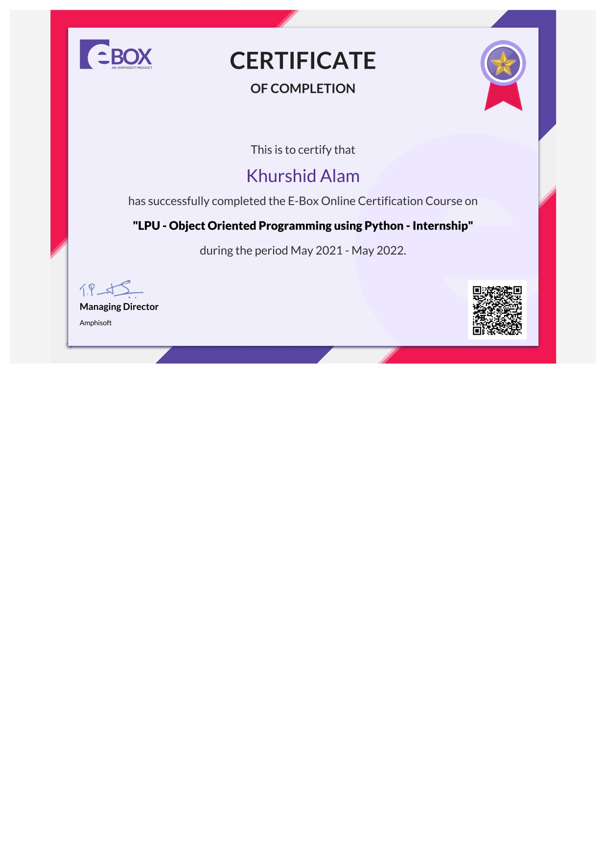

Slide 3
Course Overview
Python Basic
Data Types in Python
Conditional and If..else statement in python
Loops in python
Function
Classes and Object
Inheritance & Polymorphism
Project

Slide 4


Python Introduction
Python It was created by Guido van Rossum,
and released in 1991.
Easy to code
Interpreted Language
Dynamically Typed
Object Oriented

Slide 5
Data Types in Python
Data
Int
Float
complex
string
list
tuple
range
Numeric
Sequence
set
dict
bool
NoneType

Slide 6
Conditional and If..else statement
Conditions
If ...Elif... Else
Equals: a==b
a = 200 b = 33 if b > a: print("b is greater than a") elif a == b: print("a and b are equal") else: print("a is greater than b")
Not Equals: a!=b
Less than: a<b
Greater than: a>b
Less than or equal to: a<=b
Greater than or equal to: a>=b

Slide 7
Loops in Python
Initialization
For loop
Loop Body
A for loop is used for iterating over a sequence (that is either a list, a tuple, a dictionary, a set, or a string).
if the condition is true
Condition
#Print each fruit in a fruit list
fruits = ["apple", "banana", "cherry"] for x in fruits: print(x)
if the condition is false

Slide 8
Loops in Python
While loop
The Break statement
With the break statement we can stop the loop even if the while condition is true.
With the while loop we can execute a set of statements as long as a condition is true.
#Print i as long as i is less than 6:
i = 1 while i < 6: print(i) i += 1
#Exit loop when i is 3
i = 1 while i < 6: print(i) if i == 3: break i += 1

Slide 9
Function in Python
A function is a block of code which only runs when it is called.
We pass data, known as parameters, into a function.
#Creating a function
def my_function(): print("Hello from a function")
#Call a function my_function()

Slide 10
Classes and Objects
Classes
Objects
A class is a user-defined blueprint or prototype from which objects are created.
Classes provide a means of bundling data and functionality together.
Creating a new class creates a new type of object, allowing new instances of that type to be made.
An Object is an instance of a Class.
A class is like a blueprint while an instance is a copy of the class with actual values.
It’s not an idea anymore, it’s an actual object

Slide 11
Classes and Objects
# This is a class
class Person:
# attributes means variables
name = 'Raju'
age = 20
# actions means functions
def talk (cls):
# instance to person class
P1 = person()

Slide 12
Thank You

